Slide 1

Challenges Facing Modern Society and Suggested Solutions
Modern society faces numerous challenges that impact our well-being, sustainability, and future. These challenges are interconnected and require innovative solutions to address their root causes and create a better future for all.
John Denge

Slide 2
Mental Health Crisis
Rising Prevalence
Impact on Individuals
Societal Implications
The prevalence of mental health disorders such as depression, anxiety, and stress-related conditions is increasing, impacting individuals' well-being, productivity, and social relationships.
Mental health issues can lead to various challenges, including difficulty concentrating, decreased motivation, social withdrawal, and strained relationships.
The mental health crisis has a significant impact on society, resulting in increased healthcare costs, reduced workforce productivity, and societal strain.

Slide 3

Access to Mental Health Services
1
Increased Availability
2
Affordable Care
Expanding access to mental health care professionals, particularly in underserved areas, is crucial.
Lowering the cost of mental health services, including therapy sessions and medication, is essential to ensure affordability for all.
3
Diverse Services
4
Reduced Stigma
Providing a range of mental health services, including individual therapy, group therapy, and online platforms, is vital to meet diverse needs.
Eliminating the stigma associated with seeking mental health help is essential to encourage individuals to prioritize their well-being.

Slide 4




Public Awareness
Education
Comprehensive education programs on mental health topics, from early childhood to adulthood, can foster understanding and empathy.
Media Representation
Positive and accurate media representation of mental health issues can help destigmatize and normalize seeking help.
Community Involvement
Promoting community initiatives and support groups focused on mental health can create a sense of belonging and provide resources.

Slide 5


Workplace Wellness
Mental Health Days
Flexible Work Arrangements
Providing paid mental health days allows employees to prioritize their well-being without fear of job security.
Flexible work schedules and remote work options can reduce stress and improve work-life balance.
Employee Assistance Programs
Stress Management Training
Offering confidential counseling and support services to employees can provide access to professional help when needed.
Providing workshops and resources on stress management techniques can equip employees with coping skills.

Slide 6

Technological Addiction
1
Digital Overload
Constant exposure to digital devices and social media can lead to sensory overload and cognitive fatigue.
2
Sleep Disruption
The blue light emitted from screens can interfere with sleep patterns, impacting overall health and well-being.
3
Social Isolation
Excessive technology use can lead to decreased face-to-face interactions and feelings of social isolation.
4
Mental Health Impact
Technological addiction can contribute to anxiety, depression, and low self-esteem.

Slide 7





Digital Detox
Power Off
Regularly disconnecting from digital devices can help reduce stress, improve focus, and enhance sleep quality.
Time Limits
Setting time limits for technology use can prevent excessive consumption and create more time for meaningful activities.
Tech-Free Zones
Designating specific areas or times as technology-free zones can encourage face-to-face interactions and create a sense of presence.
Outdoor Activities
Engaging in outdoor activities, such as hiking, biking, or simply taking a walk in nature, can provide a refreshing break from technology.

Slide 8

Promoting Healthy Tech Habits
Awareness
Educate people about the potential downsides of excessive technology use, such as addiction, sleep disruption, and social isolation.
Mindfulness
Encourage mindful technology use, focusing on the present moment and avoiding distractions.
Digital Wellness Apps
Promote the use of digital wellness apps that track technology usage, set limits, and provide insights.
Balance
Emphasize the importance of balancing technology use with other activities, such as hobbies, social interactions, and outdoor time.

Slide 9


Sustainable Living
Renewable Energy
Sustainable Agriculture
Transitioning to renewable energy sources like solar, wind, and hydro power can reduce reliance on fossil fuels and mitigate climate change.
Supporting sustainable agricultural practices, such as organic farming, permaculture, and regenerative agriculture, can protect biodiversity and promote healthy soil.

Slide 10
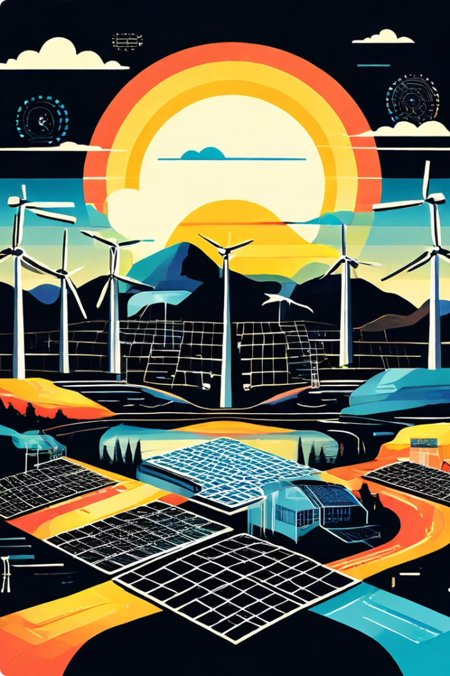
Renewable Energy
1
Government Incentives
Providing financial incentives and tax breaks for renewable energy investments can encourage widespread adoption.
2
Technological Advancements
Investing in research and development to improve the efficiency and affordability of renewable energy technologies is crucial.
3
Public Education
Raising public awareness about the benefits of renewable energy and the urgency of transitioning to a sustainable energy future is essential.
4
Infrastructure Development
Expanding the infrastructure needed to support renewable energy generation, transmission, and distribution is key to a successful transition.

